Slide 1

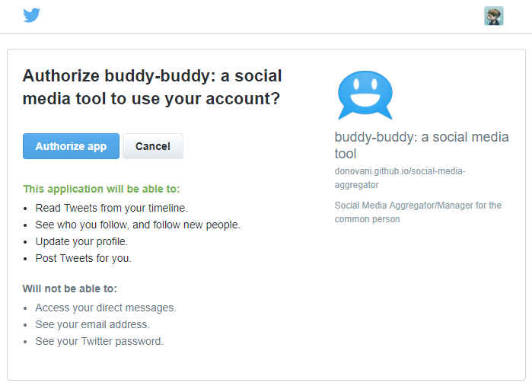




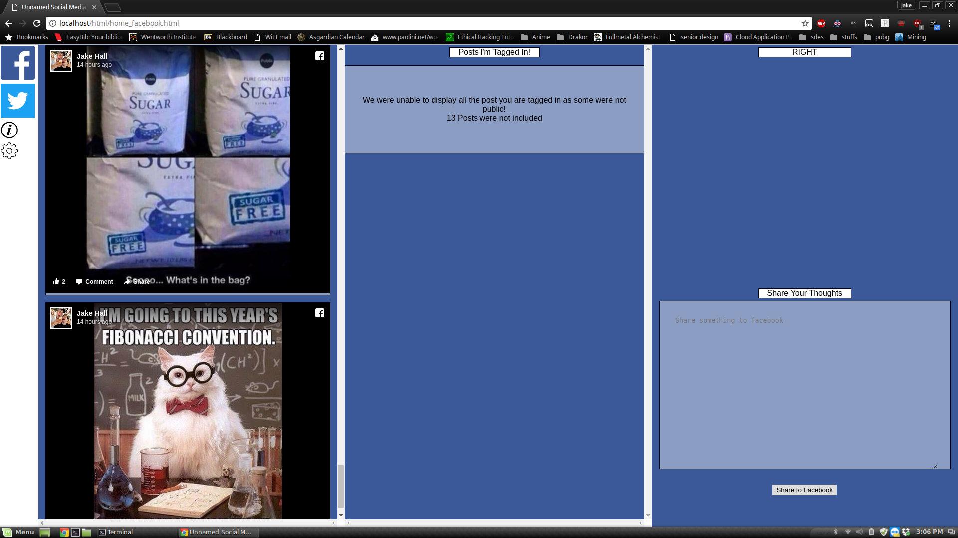
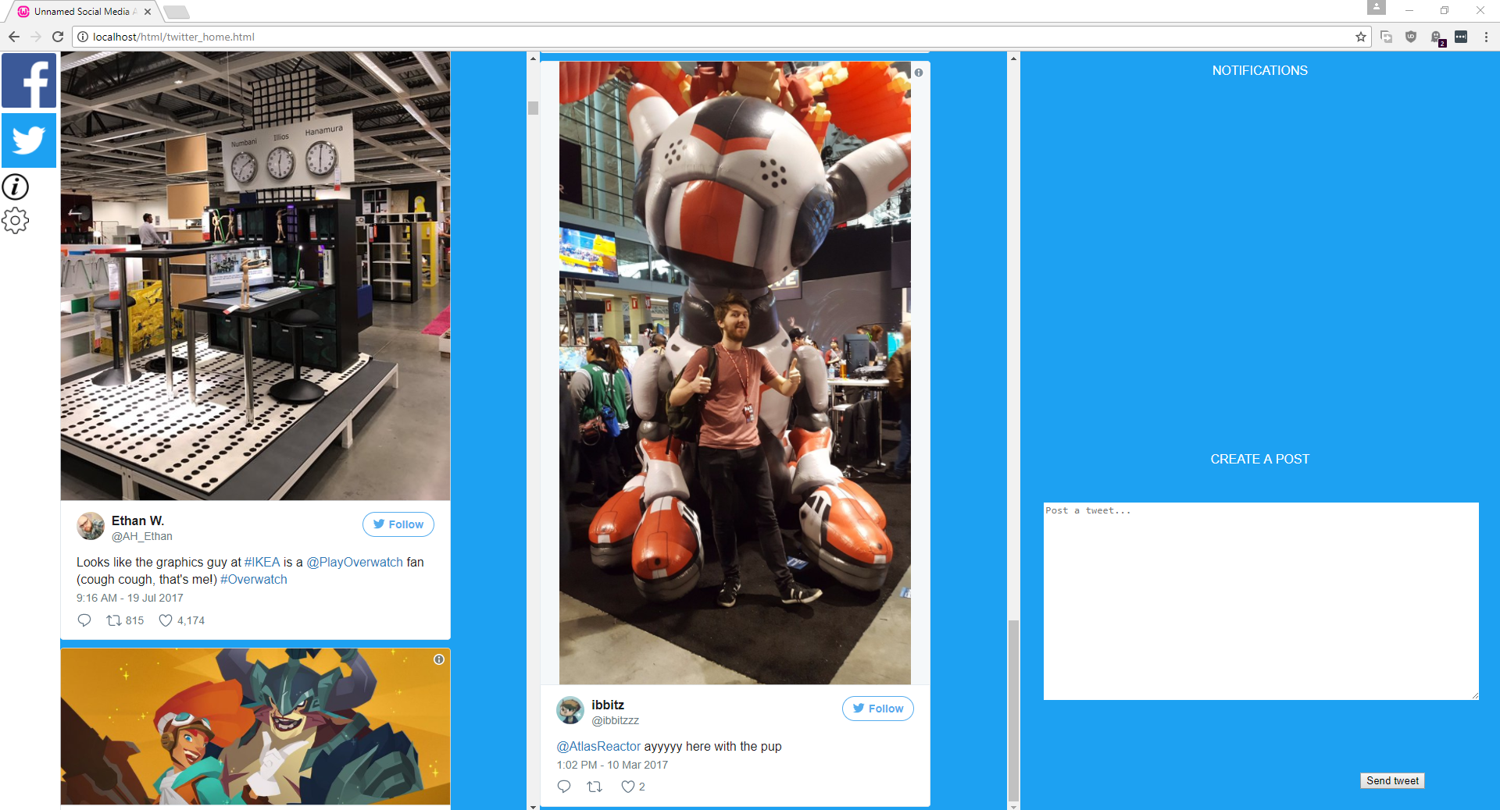
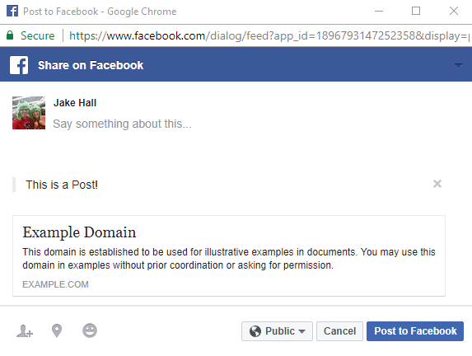
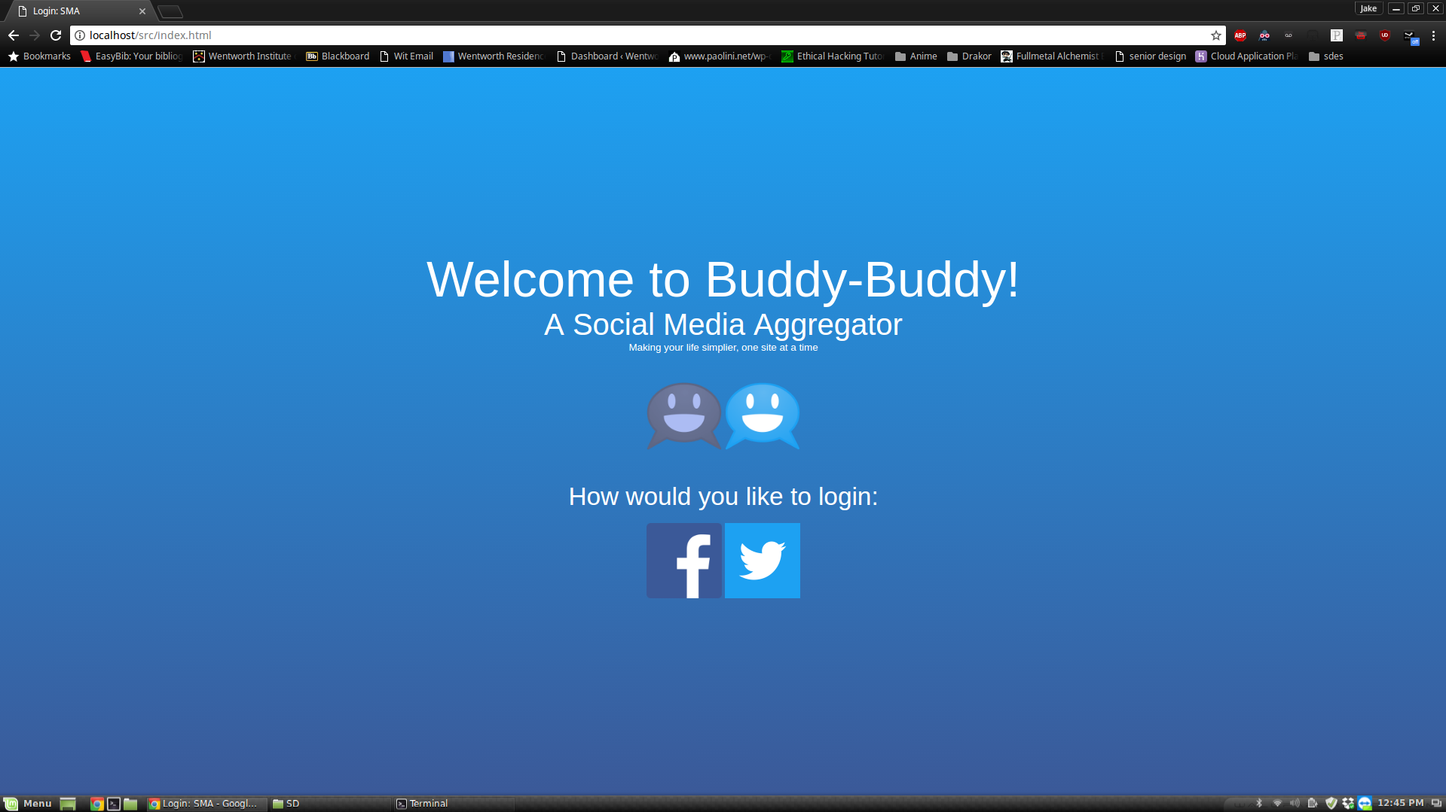
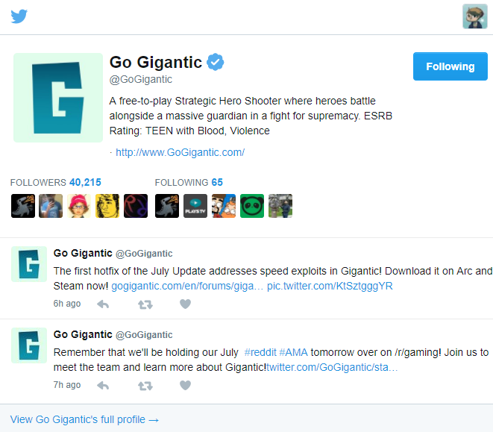
Buddy-Buddy
Jake Hall and Ian Donovan with Professor Deligiannidis
Wentworth Institute of Technology
College of Engineering & Technology, Department of Computer Science & Networking
Introduction
Design - Facebook
Design - Twitter
Conclusions
Buddy-Buddy is a social media aggregator.
That is, it is a website which allows users to access all their news feeds and profiles for every common social media platform in today’s day and age. For this project, we implemented Facebook and Twitter.
Rather than polluting screen space in your browser, Buddy-Buddy consolidates it all into one place. After signing in using first-party OAuth buttons, a user could check their relevant posts across all platforms, as well as make posts to those social media platforms.
Facebook implementation was achieved through implementation of the Facebook SDK using JavaScript. The SDK allowed up to implement Facebook’s pre-designed log in functions as well as post requests for data from a user.
Utilizing these requests, we were able grab a user’s newsfeed, posts they are tagged in, and allow them to share something to their wall.
Twitter API requests were handled using a PHP Twitter API wrapper called TwitterOAuth.
This let us
quickly make
the OAuth
steps work,
with the brunt
of the coding being asynchronous Javascript functions and callbacks to process the API responses.
Once embedding posts was handled correctly, the rest was fairly straight forward, with the only limitation being that certain interactions needed to be handed through Twitter’s modals.
Overall, I believe that this project is successful. Functionally, buddy-buddy is able to accomplish core social media functionality and present it in a logical manner. We believe that the potential for a good product is there, but the combination of time constraints, our technology stack, and limitations of the platform APIs hurt us.
In many cases we had to sacrifice some of our structure/cleanliness to get things to work. Neither of us had prior web development experience, and that translated to us not having as much time to reiterate and refactor our code.
Regardless, this was a positive learning experience; we came out with a stronger understanding of advanced APIs, fundamental web development, and a better perspective overall.
Bibliography
Facebook SDK: https://developers.facebook.com/docs/javascript
Twitter Developer Portal: https://dev.twitter.com
TwitterOAuth: https://twitteroauth.com

